Slide 1
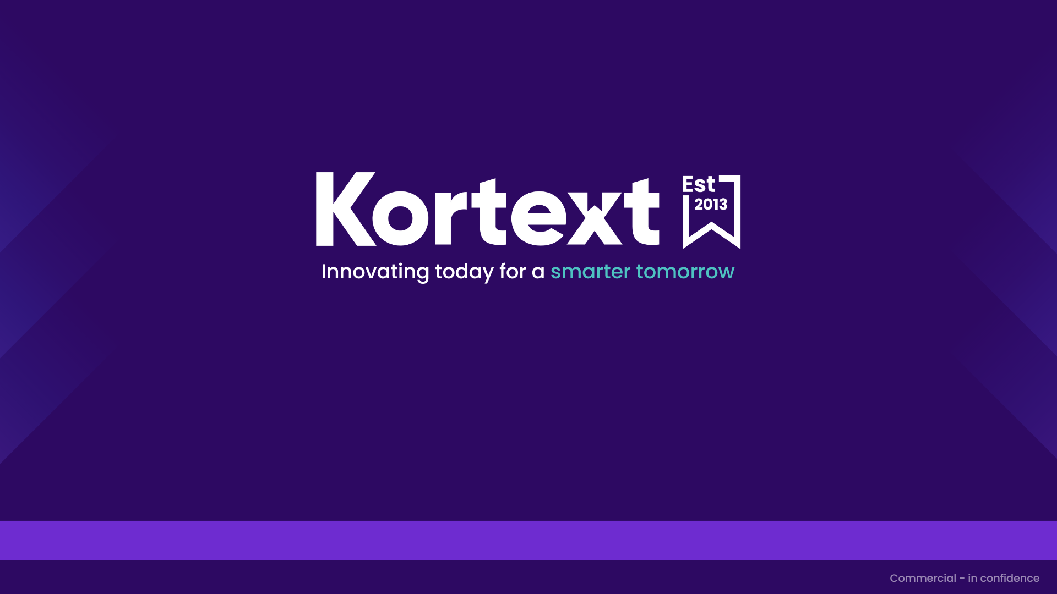
Introducing Kortext study+
AY 2025-2026

Slide 2


Slide 3


Creating study notes in the Kortext study platform
Create study notes by highlighting a piece of text or create a note for the whole page. Notes can be shared with groups, via email or OneNote. Additionally, you can save notes to a Workbook.

Slide 4
Smart studying, redefined
Create study notes & make flashcards
Search by keyword to find relevant titles
Upload content using My files
Listen along using read aloud
Create accurate citations instantly
Collaborate with peers using Groups

Slide 5
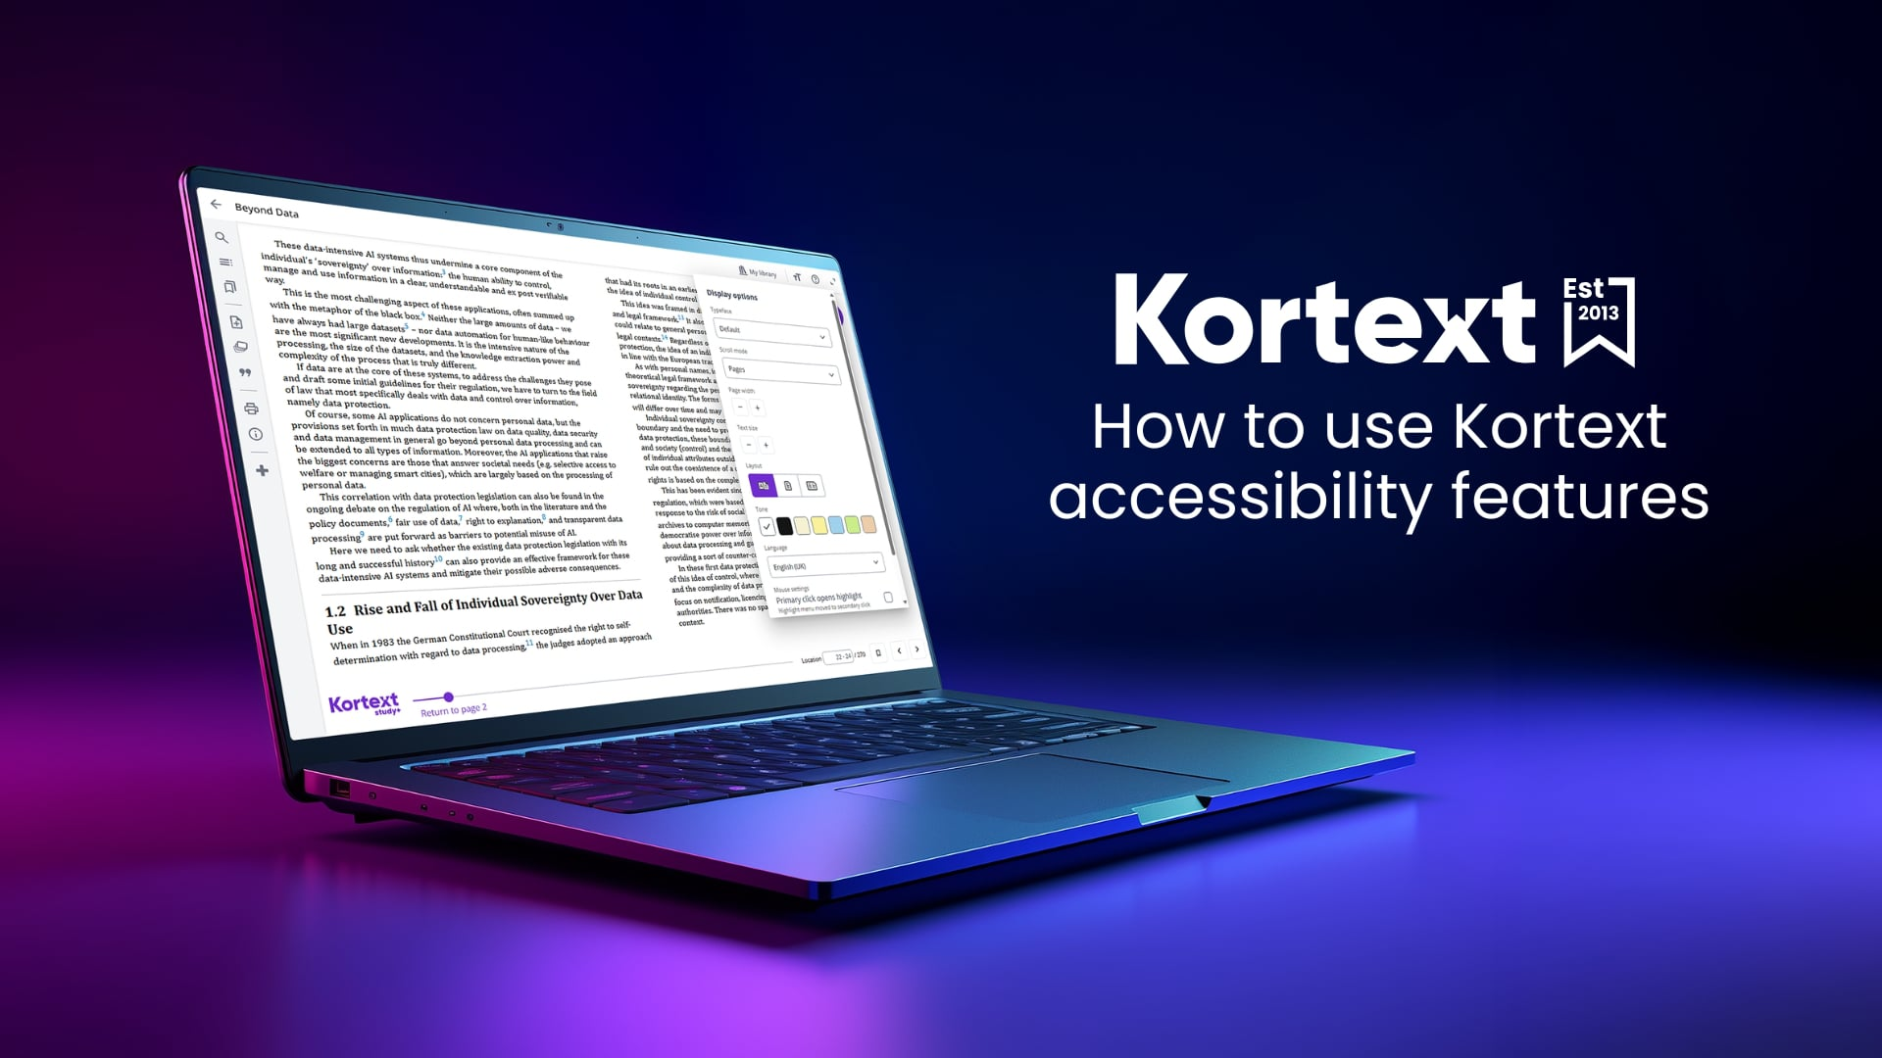

Slide 6



Accessibility tools
Read aloud
Text & background
Display options
Convert text to speech in both EPUBs and PDFs. Choose your preferred narrator, select the speed, and skip forward or back as needed. Our app is also compatible with screen reading software like NV Access, JAWS, TalkBack and VoiceOver.
Customise your reading experience in EPUBs. Select your preferred font style (including OpenDyslexic), colour and text size. Adjust line spacing, margins and justification. Opt for dark mode or use one of several coloured backgrounds.
Navigate through EPUBs using scroll or pages mode and auto, single- or double-page view. In PDFs, enlarge text using magnification tools. In EPUBs, change the font style or increase the font size to reflow text in the eReader screen.

Slide 7
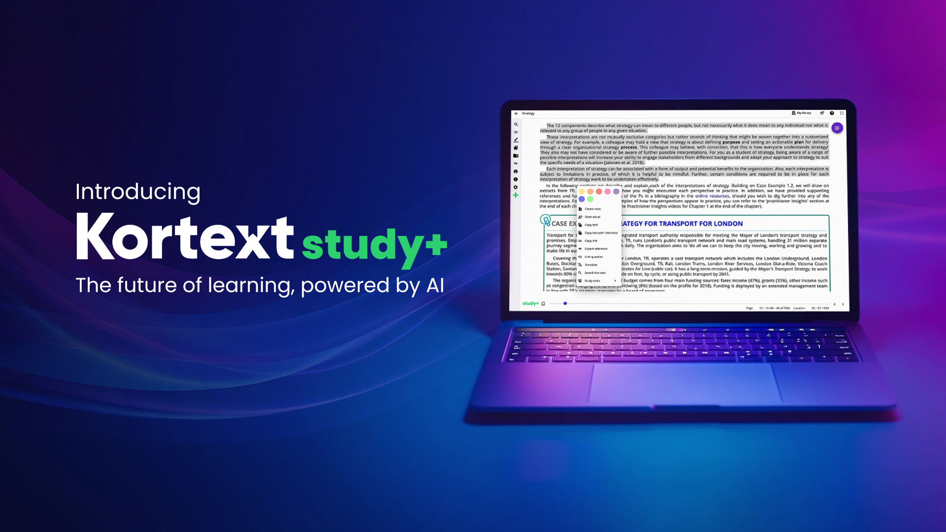

Slide 8


Kortext study+ features
Cutting-edge generative AI software summarises sections of text in a matter of seconds, making studying significantly more time efficient.
Embracing the diverse landscape of higher education, our platform allows for translation of content into 135 global languages.
Students can reinforce their learning and challenge themselves with our innovative, AI-generated question and answer tool.
Kortext study+ users get 5GB of cloud storage space, while also having the ability to apply our AI study tools to any self-loaded content.
Automatically generated study notes allow the busy student of today to digest the information they need more quickly and easily.

Slide 9




Download our apps on mobile, tablet or desktop
Android
iOS & Mac
Windows
Learn anytime, anywhere, and on any device with Kortext study. Our popular native and mobile apps allow for limitless learning, helping support the busy modern student with instant access to the content they need.

Slide 10


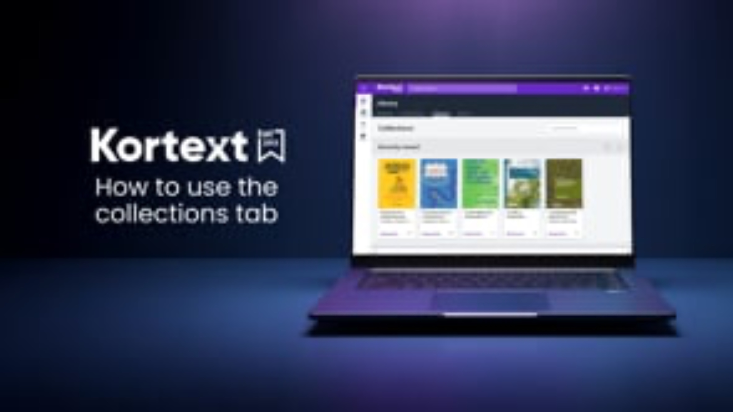

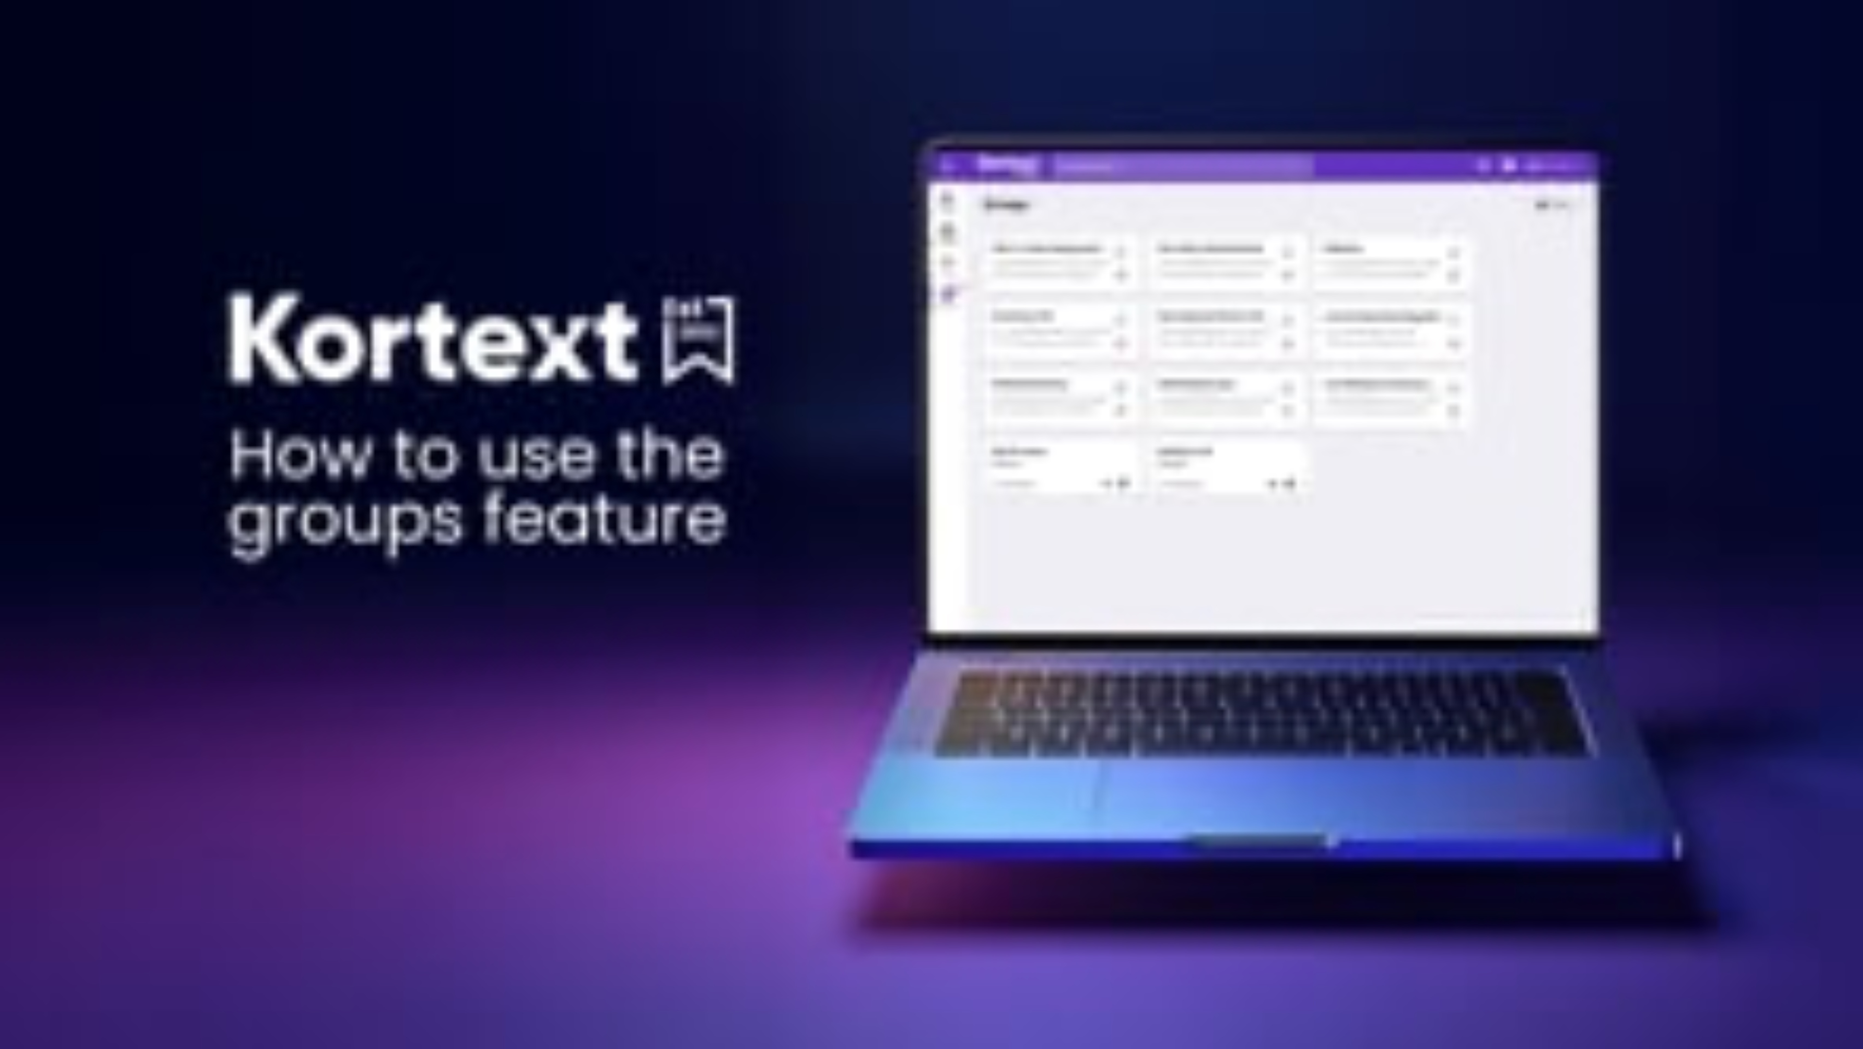

Videos

Slide 11

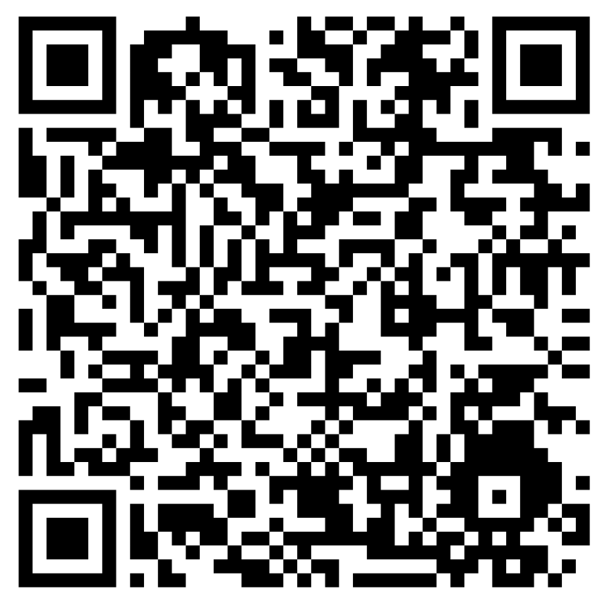
Student hub
The Kortext student hub is a dedicated website with blogs, video tutorials and essential resources to help students make the most of our smart study space. Click here to visit or scan the QR code.

Slide 12

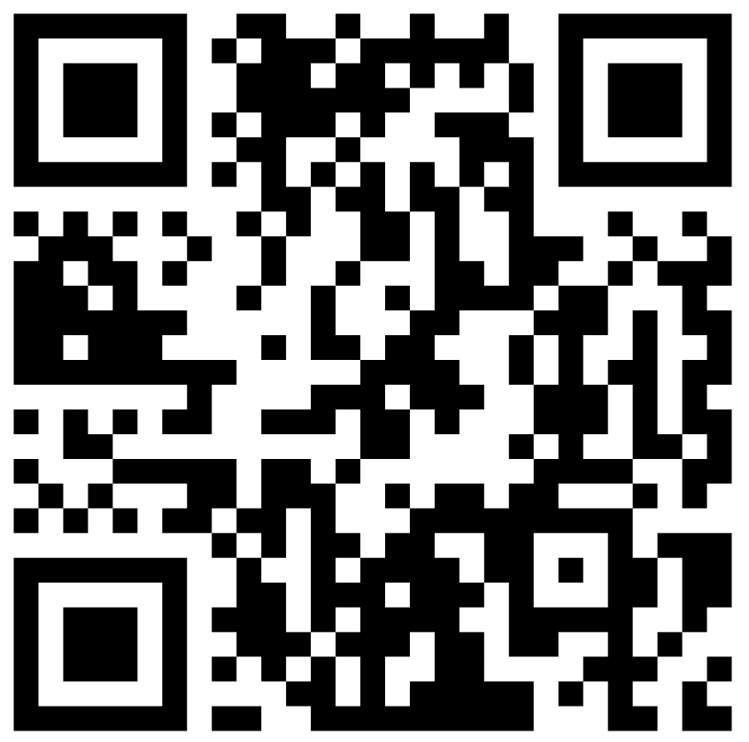
How to access support
Need help accessing your books or using the online reader? Click here to contact our support team or scan the QR code.

Slide 13
Thank you for your attention

